Slide 1
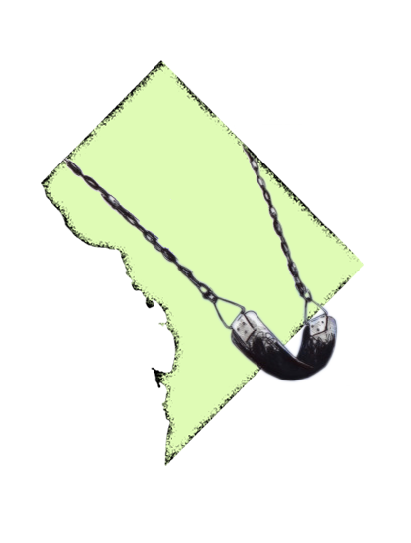

Correcting Inequitable Access to Physical Activity Spaces Through Community-Participatory Policy Development
Active Kids,
Healthy
Community
Nancy Chapman, MPH, RD
Stephanie Johnson, RDN, LD

Slide 2
Presenter Disclosures
Nancy Chapman, MPH, RD
The following personal financial relationships with commercial interests relevant to this presentation existed during the past 12 months:
  Robert Wood Johnson Foundation Voice for Healthy Kids
  American Heart Association – Mid-Atlantic Affiliate

Slide 3
Objectives
Identify two sources of data that demonstrate inequity in availability of recreational facilities in low income communities.
Differentiate between advantages and disadvantages of two alternative approaches to achieve policy changes that stimulate shared use of school recreation facilities.
Describe the impact of communicating community participatory research findings to mobilize community and government support for improving access to school recreational facilities in underserved communities.

Slide 4
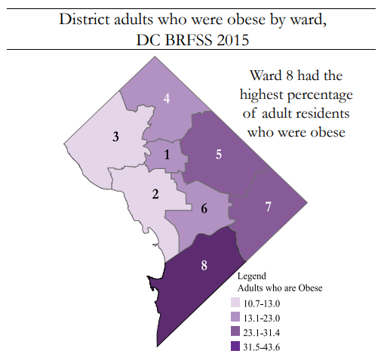
District of Columbia Statistics
About 70% of DC adult residents in Wards 5, 7, and 8 are either overweight or obese
3.7 times more African American residents are obese than white residents
3 times more African American residents did not exercise in the last 30-days than white residents
http://www.dchealthmatters.org/content/sites/washingtondc/2016_DC_CHNA_062416_FINAL.pdf
https://dchealth.dc.gov/sites/default/files/dc/sites/doh/publication/attachments/DC%20BRFSS%202015%20Annual%20Report%20-%20Web%20Edition.pdf

Slide 5
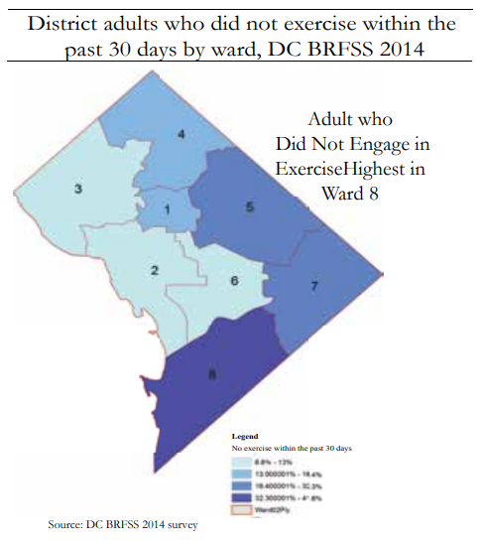
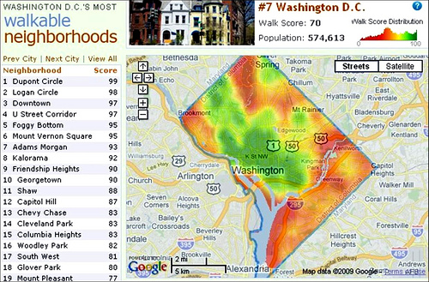
Walkability and Physical Activity
https://www.smartcitiesdive.com/ex/sustainablecitiescollective/outstanding-walkabilitylivability-presentation-dc-planning-staff/7538/
https://dchealth.dc.gov/sites/default/files/dc/sites/doh/publication/attachments/BRFSS_Annual_Report_2014.pdf

Slide 6
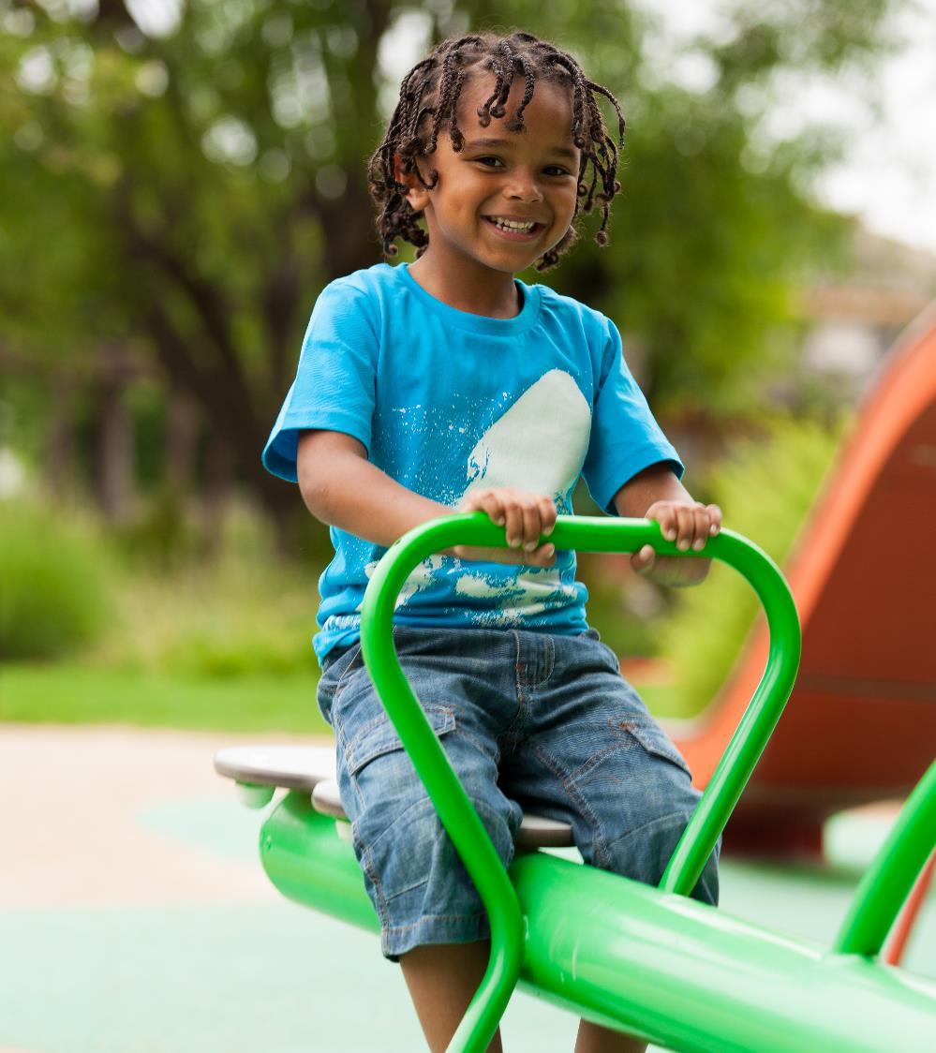
Shared Use
“Shared use”, also called “joint use” or “community use”, occurs when government entities (i.e. public schools) agree to open access to their property and/or facilities, such as recreational spaces, for community use. These require formal agreement.

Slide 7
Making the Case
Active Kids,
Healthy
Community
Used community participatory research theory to engage community residents in identifying needs, suggesting solutions, and advocating for change.

Slide 8
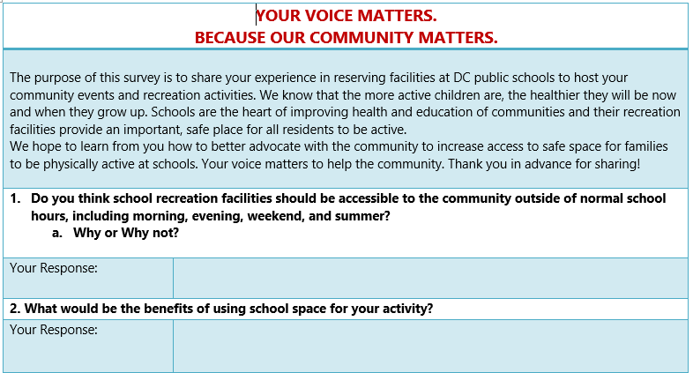
Making the Case
Community and Stakeholder Surveys
Surveyed
  Community groups
  School principals
  Government agencies
Created report and communications materials

Slide 9
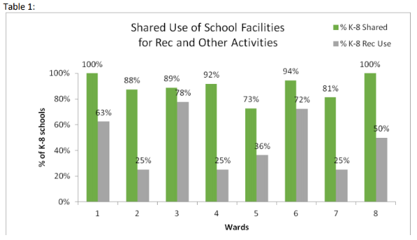
Making the Case
FOIA Request for Government Data
Analysed data on shared use agreements over a two-year period
Prepared report and communications materials
https://docs.wixstatic.com/ugd/794085_dc72253d3a5f4d5eb91002bba478344c.pdf

Slide 10
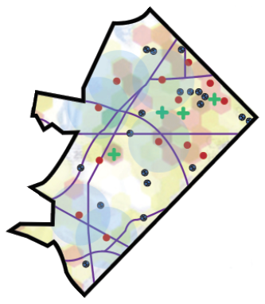
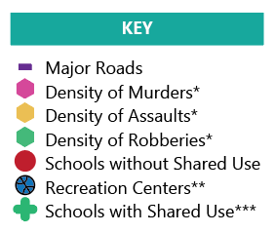
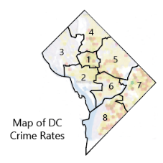
Maps of DC Physical Activity Deserts
KEY
www.DCActiveKids.org

Slide 11
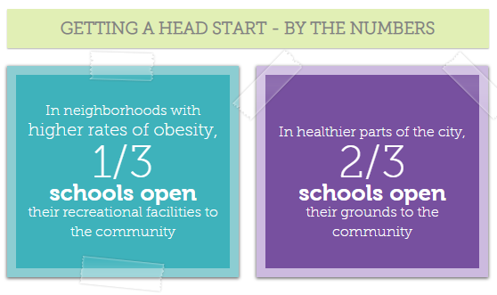
www.DCActiveKids.org
Attaining equity to safe, clean places to play is key to improving health for the District's kids.

Slide 12

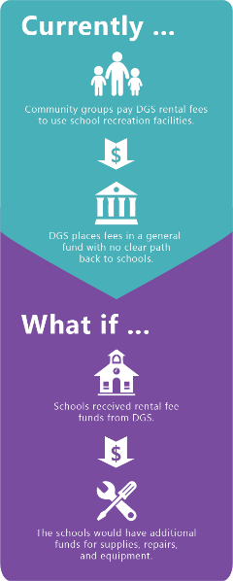
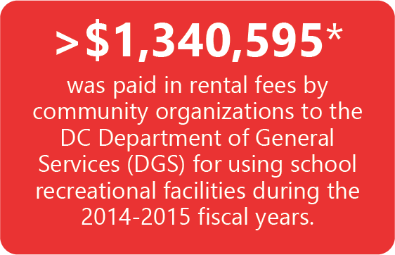
A School Funding Opportunity
www.DCActiveKids.org

Slide 13
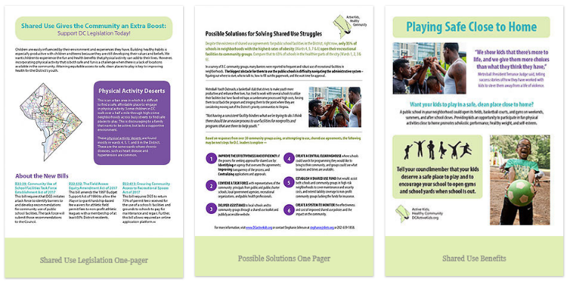
Community Outreach
Email and You’re the Cure Campaigns
Website
Working Group Formed
Visits to playgrounds
Meeting presentations
TV Interviews
Letter to the Editor
www.DCActiveKids.org

Slide 14

Shared Use Working Group Members
Non-profit organizations providing exercise for residents
For-profits organizations providing exercise for residents
Universities
DC Government Agencies
  DC Office of the Deputy Mayor for Education
  Office of State Superintendent for Education
  DC Public Schools
  DC Department of Health
  DC Department of Parks and Recreation
  DC Office of Planning

Slide 15
Working Group Report
Report
Recommendations
Based on problems and solutions suggested by the community
Report shared by WG members with:
  Mayor’s Office
  DC Agencies
  DC Council Members
  Media
Update application process
Change the fee structure
Return funds to schools
Provide technical assistance
Evaluate future use of agreements
Continue to promote physical activity

Slide 16
What happened?
Active Kids,
Healthy
Community
Administrative and Legislative Successes

Slide 17
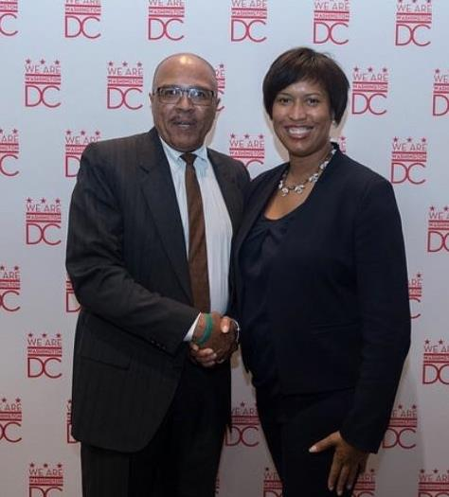
Administration
Attendance at Working Group Meetings
Creation of the Mayor’s Advisory Group on Community Use of Public Spaces
  Electronic registration
  Fees and waivers
  Hours of Operation
  Accessibility to DC Public Schools
Working Group member appointed to the Advisory Group
Notes:
Committee has:
1. Recommended electronic registration for use of property, system will be available spring 2019
2. Developed recommendations regarding fees and fee waivers for use of public space by organizations
3. Developed recommendations regarding playground usage and hours of operation for newly modernized schools
4. Determined areas in the District where DPR youth programming is less accessible and whether DCPS facilities can be used in these areas after school

Slide 18
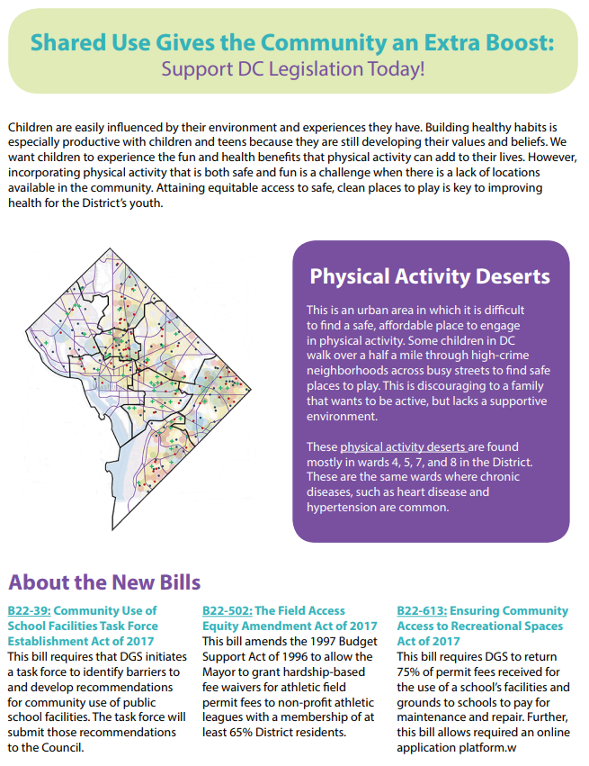
Legislation
Working Group members testified and presented report to DC Council
Legislators combine three bills into B22-613, the Ensuring Community Access to Recreational Space Act of 2017 that would:
  Standardized process for online shared use applications
  Return 75% of permit fees back to the schools to cover the costs associated with use of the fields and facilities
  Create a system for CBOs from underserved neighborhoods to apply for fee waivers, to cover their costs, and to ensure access to facilities
  Formalize and establish the community use task force
Committee on Transportation and Commerce approved B22-613 on September 9 and DC Council approved it October 16.
Notes:
Committee on Transportation and Commerce, chaired by a health champion DC Councilwoman Mary Cheh, approved B22-613 on September 9

Slide 19

Lessons Learned
Engage government agencies, recreational professionals, school-based organizations, and residents that provide diverse perspectives
Plan an administrative solution as well as legislative tactics
Plan for several iterations of legislation and pick the best person to introduce bill
Provide adequate time to achieve objectives and sustain community engagement
Incorporate plans for implementing legislation and promoting physical activity and shared use agreements

Slide 20
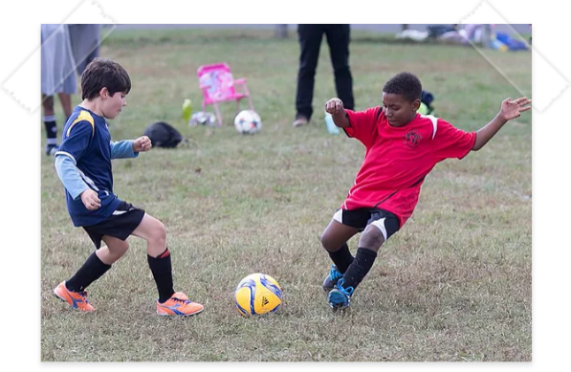
Conclusion
Compelling data on inequity of access to recreational facilities and engaging communications persuaded DC Council and Mayor to formulate specific policies that correct inaccessibility to school facilities and increase numbers of individuals being physically active in underserved neighborhoods.
Connecting the community and stakeholders early empowers a broad group of residents to construct and advocate for changes their community both needs and wants.

Slide 21
Thank You Shared Use Working Group Members
Community-Based Organizations |  | DC Government Agencies
Alliance for Healthier Generation | District Sports | DC Public Schools
American Heart Association | George Washington University, School of Public Health | Department of Health
American Scores | Kid power | Department of Parks and Recreation
BOKS | National Association of Independent Schools | Office of the City Administrator
But On Loved Diamonds | United Social Sports | Office of the Deputy Mayor for Education
DC Alliance for Youth Advocates | YMCA | Office of Planning
District Dance | Young Women’s Project | Office of State Superintendent for Education

Slide 22

Thank You
Active Kids,
Healthy
Community
For follow-up questions, email Nancy Chapman at Nancy@Diets.com.

